Slide 1
Fake News Progress Report
Marian Longa, 07/08/2017

Slide 2
Method
Download 23 tweet fields from DB: tweet_id, created_at, retweet_count, text, user_screen_name, user_verified, user_friends_count, user_followers_count, user_favourites_count, tweet_source, geo_coordinates, num_hashtags, num_mentions, num_urls, num_media, user_default_profile_image, user_description, user_listed_count, user_name, user_profile_use_background_image, user_default_profile, user_statuses_count, user_created_at
Define 84 base + derived features (check character types, calculate per-unit-time quantities, determine trends from histograms)
For each feature calculate t-value and p-value (sort by p-value)
Select good and contentious features for ML models
Determine performances of different feature sets in logistic regression model

Slide 3
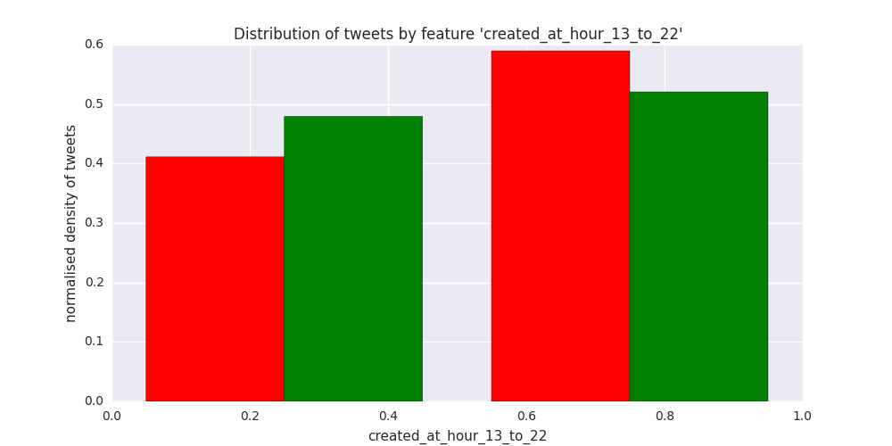
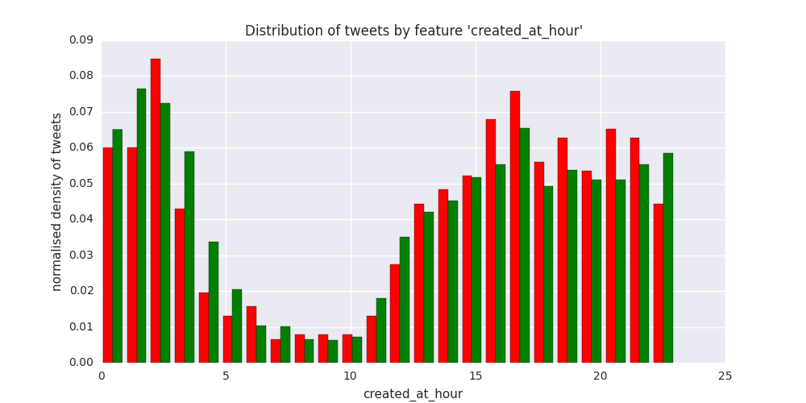
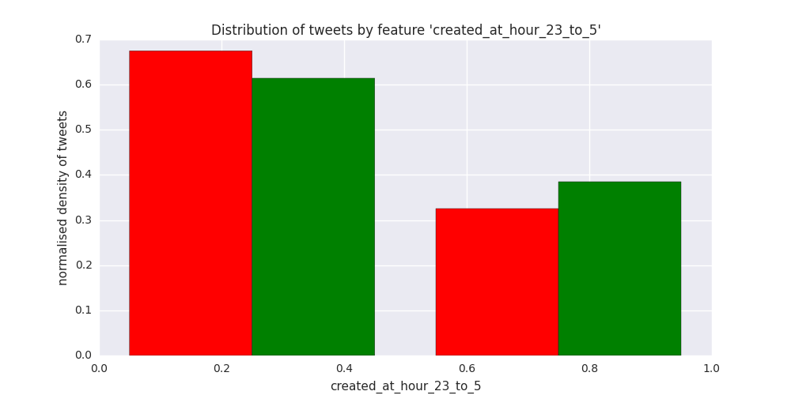
‘created_at_hour’ related features
t = +3.525, p = 0.000426
t = +2.244, p = 0.0249
t = -3.232, p = 0.00124

Slide 4
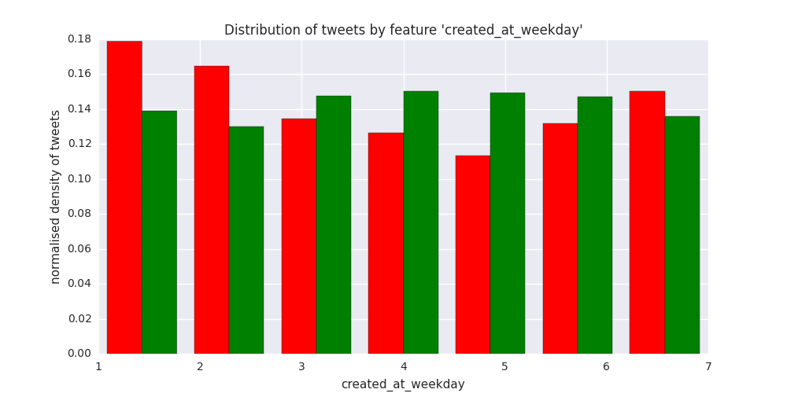
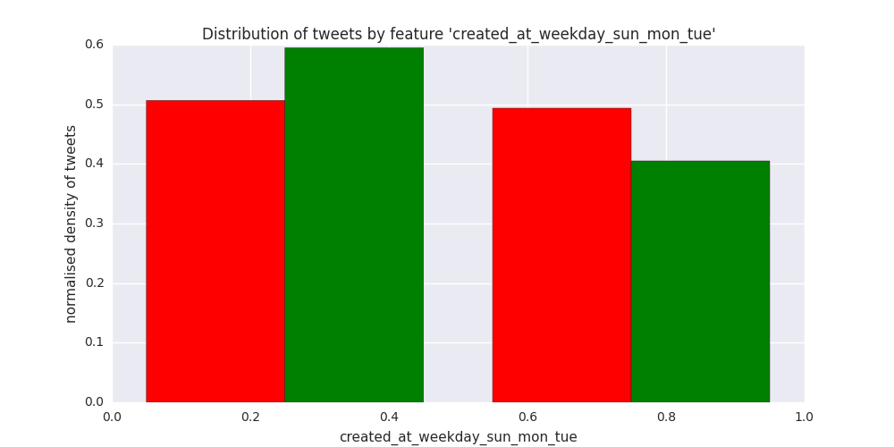
‘created_at_weekday’ related features
t = +4.628, p = 0.00000376
t = -2.594, p = 0.00950

Slide 5
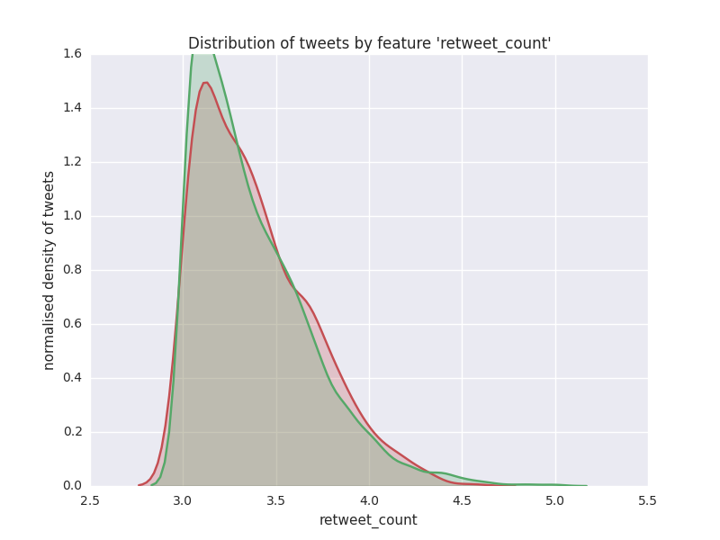
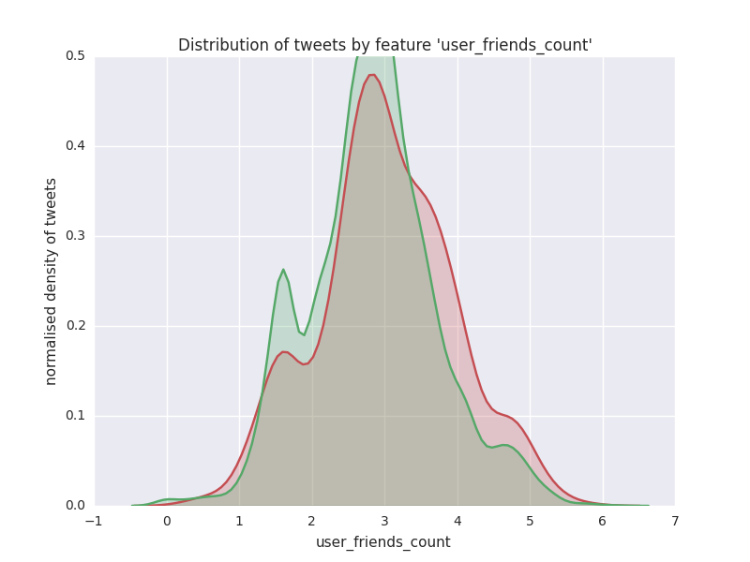
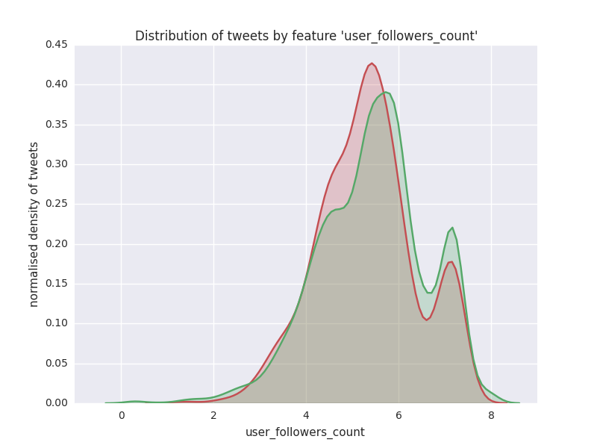
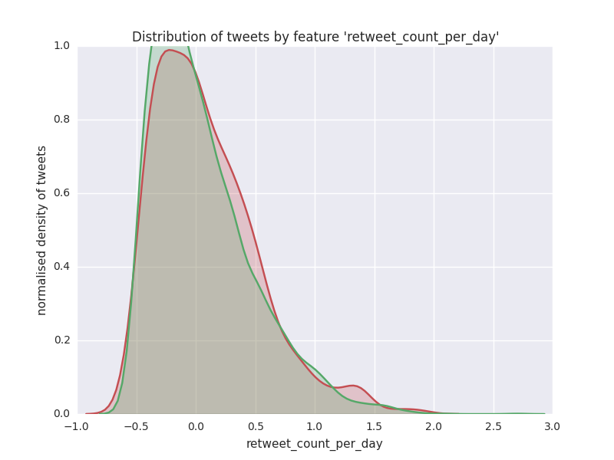
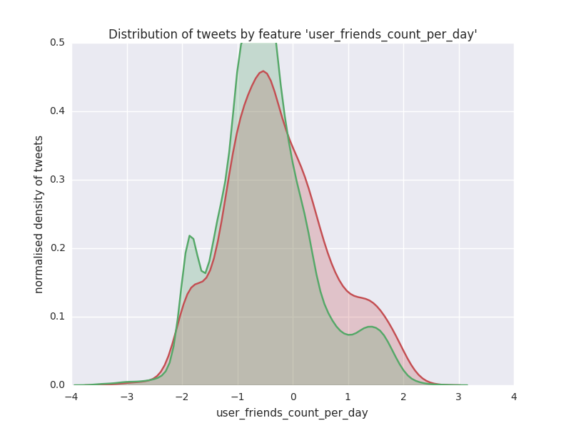
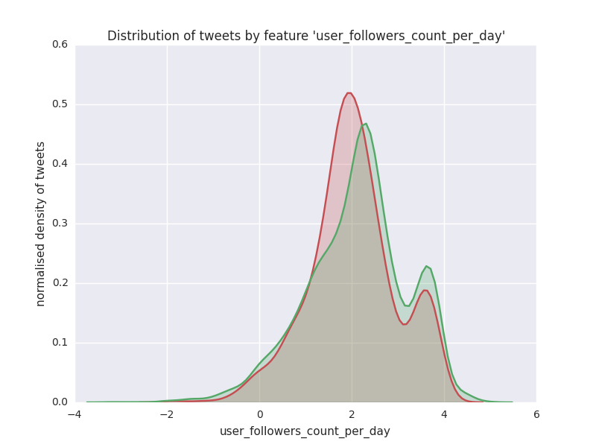
per-unit-time related features
t = -0.639, p = 0.522
t = +2.144, p = 0.0320
t = -3.263, p = 0.00111
t = +0.711, p = 0.477
t = +3.365, p = 0.000769
t = -3.620, p = 0.000297

Slide 6
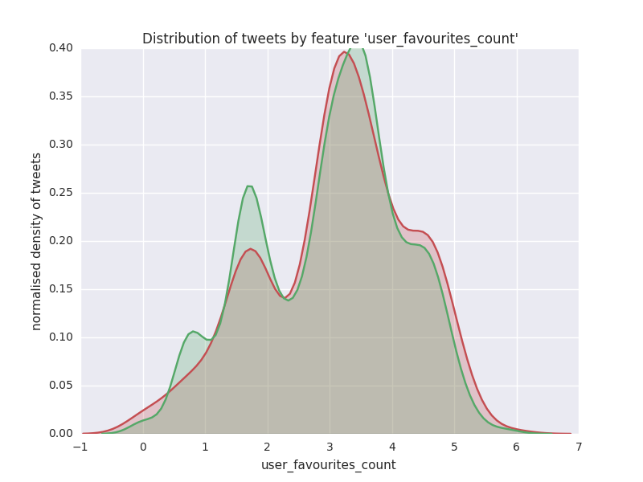
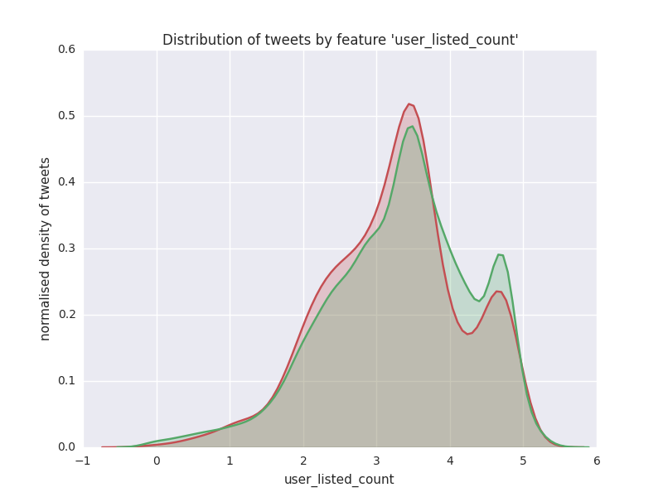
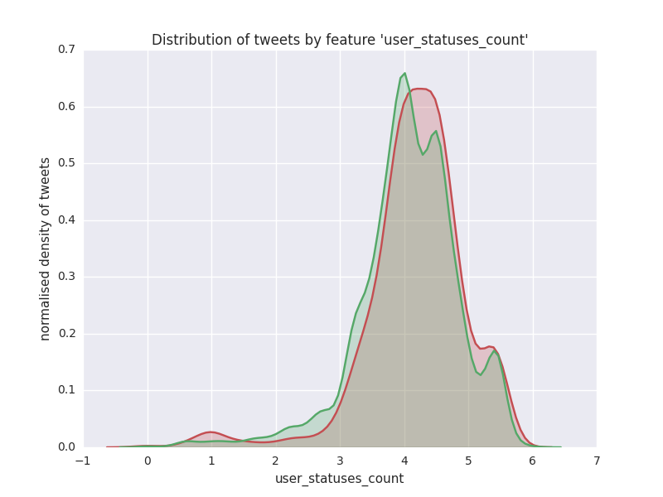
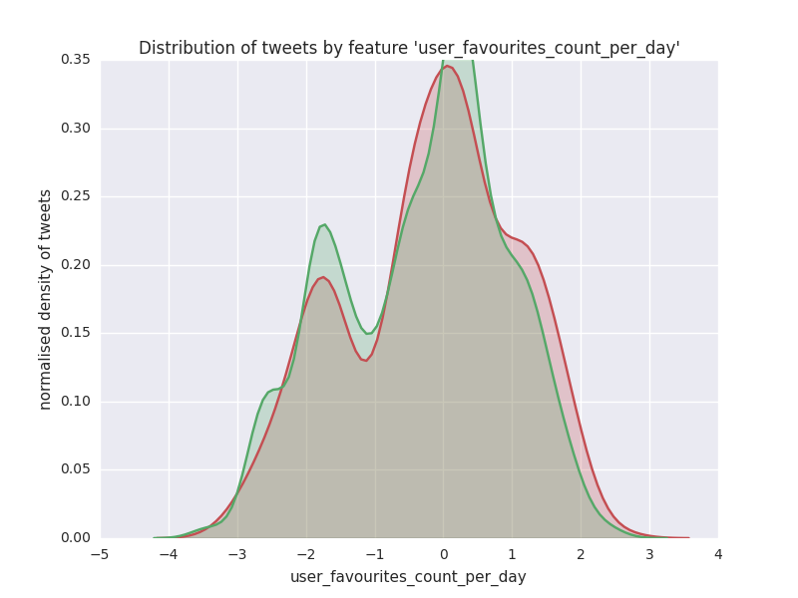
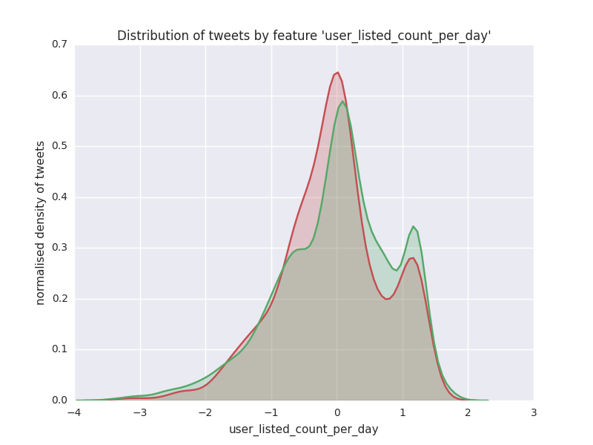
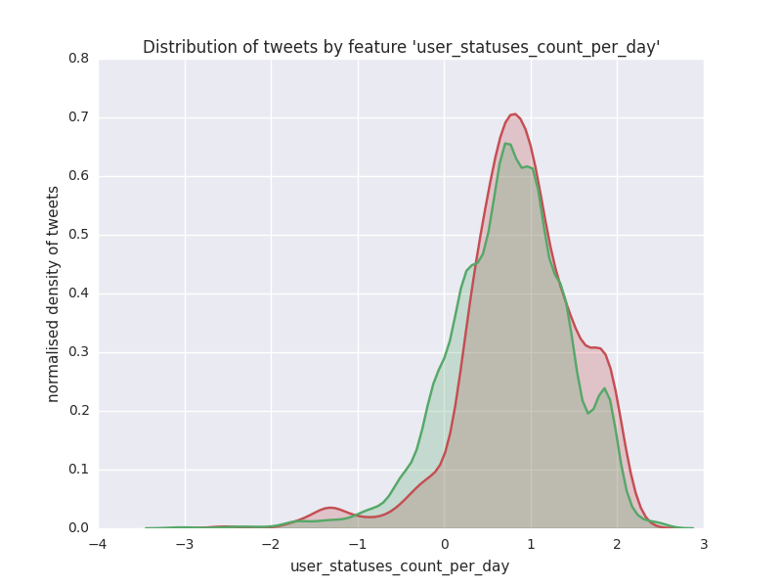
per-unit-time related features
t = +1.757, p = 0.0790
t = -2.558, p = 0.0105
t = +1.981, p = 0.0476
t = +2.554, p = 0.0107
t = -3.421, p = 0.000628
t = +3.010, p = 0.00262

Slide 7
text-related features
Feature t-value p-value
text_num_caps_digits +8.53143813421943164599 0.00000000000000001817
text_num_caps_digits_exclam +8.31773186198049252482 0.00000000000000011032
text_num_caps +7.37300603310724245176 0.00000000000018982640
text_num_caps_exclam +7.16504376471533177551 0.00000000000087281045
text_num_digits +7.05903629667134602244 0.00000000000186958317
text_num_swears -2.98705738725803726652 0.00282836836204724152
user_screen_name_has_caps_digits +6.79642373214002759596 0.00000000001178100595
user_screen_name_has_caps_digits_underscores +5.70757823906140782100 0.00000001201798678693
user_screen_name_num_caps_digits +5.82872389377630195639 0.00000000588121100628
user_screen_name_num_caps_digits_underscores +5.59828483311374114351 0.00000002262544180715
user_screen_name_has_caps +5.35583999643755248599 0.00000008838704498429
user_screen_name_num_caps +4.59584925458091486661 0.00000439979639098320
user_screen_name_num_caps_underscores +4.35609937975342464966 0.00001346469570402121
user_screen_name_has_caps_underscores +4.17420324343184212523 0.00003033387736915433
user_screen_name_has_digits +4.00926857794722035777 0.00006165950921821625
user_screen_name_num_digits +3.43921080298013759347 0.00058745594493451049
user_screen_name_num_digits_underscores +2.85569244490447982088 0.00430932407291492996
user_screen_name_num_weird_chars +2.85569244490447982088 0.00430932407291492996
Feature t-value p-value
user_description_num_exclam +3.90125937312726689399 0.00009675917875963300
user_description_num_caps_exclam +3.14907190631085232013 0.00164608597263901277
user_description_num_non_a_to_z +2.96905167098084632471 0.00299923689022872598
user_description_num_caps +2.95790751662524042942 0.00310965737703582275
user_description_num_non_a_to_z_non_digits +2.95778568452991841298 0.00311088476024148431
user_description_num_caps_with_num_nonstandard +2.95419620171281405163 0.00314724544039675846
user_description_num_nonstandard +2.17150471079279405728 0.02993281139725200921
user_name_has_weird_chars +2.44129540958591695343 0.01466390719685074090
user_name_has_underscores +2.32226803187070451884 0.02025241432449593690
user_name_has_digits_underscores +2.21806595394656191900 0.02658832483519989187

Slide 8
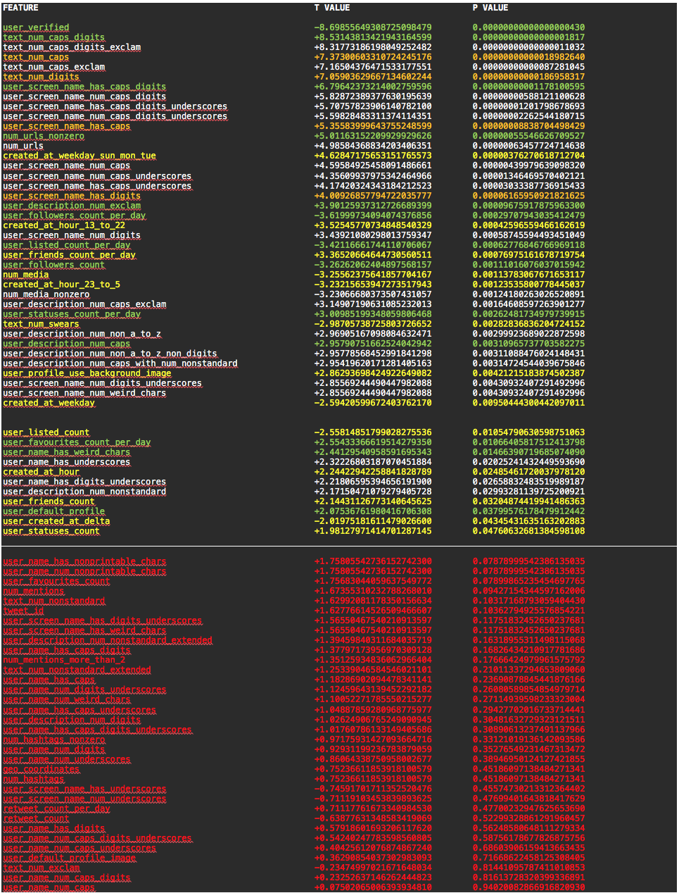
Features
p < 0.01
0.01 ≤ p < 0.05
p ≥ 0.05

Slide 9
Features

Slide 10
Features

Slide 11
Performance
basic features = features used in original paper
extended features = newly added features
few features = only reasonable features with p < 0.05
some features = reasonable and contentious features with p < 0.05
all features = all features independent of their p-value
single features = compressed features eg text_num_caps_digits
multiple features = expanded features eg text_num_caps, text_num_digits
without biasing features = removed certain features to try to decrease bias
BASIC FEATURES (FEW)
model score (binary): 0.548168
model score (probabilistic): 0.580680
bias: +0.146458
BASIC FEATURES (SOME)
model score (binary): 0.546811
model score (probabilistic): 0.596429
bias: +0.145403
BASIC FEATURES (ALL)
model score (binary): 0.594301
model score (probabilistic): 0.600106
bias: +0.076653
EXTENDED FEATURES (FEW, SINGLE)
model score (binary): 0.607870
model score (probabilistic): 0.638144
bias: -0.329007
EXTENDED FEATURES (FEW, MULTIPLE)
model score (binary): 0.620760
model score (probabilistic): 0.633091
bias: -0.300936
EXTENDED FEATURES (SOME, SINGLE)
model score (binary): 0.607870
model score (probabilistic): 0.647993
bias: -0.615988
EXTENDED FEATURES (SOME, SINGLE, WITHOUT BIASING FEATURES)
model score (binary): 0.607191
model score (probabilistic): 0.649841
bias: -0.462021
EXTENDED FEATURES (SOME, MULTIPLE)
model score (binary): 0.622795
model score (probabilistic): 0.647008
bias: -0.230240
EXTENDED FEATURES (SOME, MULTIPLE, WITHOUT BIASING FEATURES)
model score (binary): 0.620760
model score (probabilistic): 0.646215
bias: -0.450816
EXTENDED FEATURES (ALL)
Not tested because features with p > 0.05 are too insignificant
4.7% improvement
w.r.t. basic features (all)

Slide 12
Future work
Test different classification/regression models
random forests, neural nets, SVM, KNN, naive Bayes

